Slide 1

ENGINEERING CHEMISTRY
Asha A
Department of Science and Humanities

Slide 2

ENGINEERING CHEMISTRY
Module 7- Functional materials
Module content:
Polymers
Types of polymerisation
Structure - Property relationship
Commercial polymers – Butyl Rubber
Biodegradable Polymers
Epoxy resin
Polymer composites-Kevlar and Carbon Fibre
Conducting polymers
Molecular weight of Polymers
Organic LEDs

Slide 3
ENGINEERING CHEMISTRY
Module 7- Functional materials-Polymers
Class content:
Polymers
Introduction
Types of polymerisation
Glass transition temperature

Slide 4
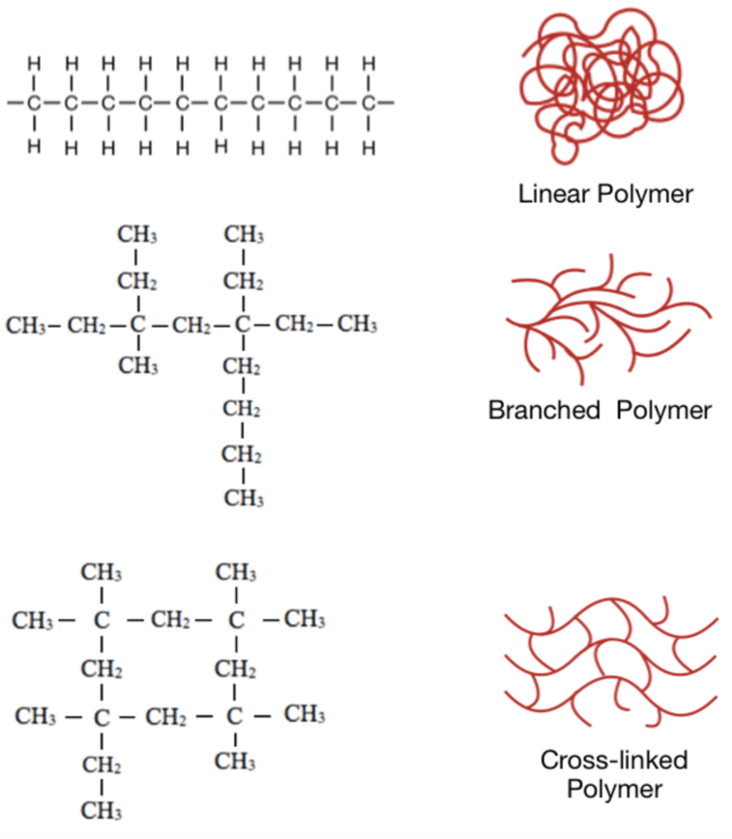
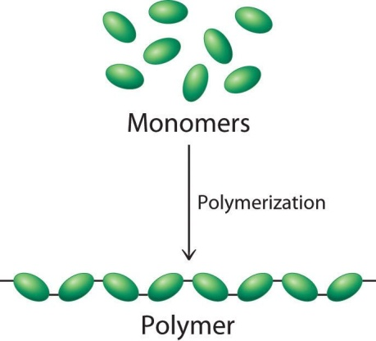
ENGINEERING CHEMISTRY
Module 7- Functional materials-Polymers
Polymers
Polymer :
A giant molecule or a macromolecule formed by repeated joining of several simple molecules
Polymers can be linear, branched or cross-linked
Source:https://www.livescience.com/60682-polymers.html
Source:https://www.researchgate.net/figure/A-schematic-illustration-of-a-linear-polymers-b-branched-polymers-and-c_fig2_323689828

Slide 5
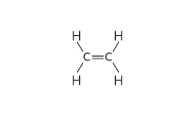

ENGINEERING CHEMISTRY
Module 7- Functional materials-Polymers
Monomer : A simple molecule , having two or more binding sites , which can be linked together to form a giant molecule
Molecule | Structure | Monomer(Yes/No)
Ethylene
Acetic acid
Ethane
Ethylene glycol
Adipic acid
Amino acid
Styrene

Slide 6
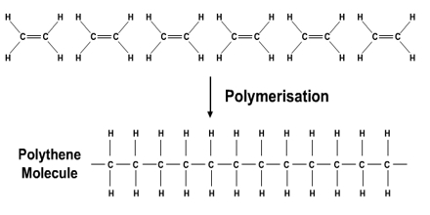
ENGINEERING CHEMISTRY
Module 7- Functional materials-Polymers
Polymerisation: The process by which monomers of low molecular weight are converted to polymers of high molecular weight
Functionality : The total number of functional groups or bonding sites present in a monomer
Source:https://www.assignmentpoint.com/science/chemistry/addition-polymerisation.html
Monomer | Structure | Functionality
Ethene |  | bifunctional
Ehtylene glycol |  | bifunctional
Glycerol |  | trifunctional
Amino acid |  | bifunctional

Slide 7
ENGINEERING CHEMISTRY
Module 7- Functional materials-Polymers
Degree of polymerisation(DP) :
The total number of repeat units in a polymer chain
DP =
It can be used to
determine length of the polymer chain
molecular weight of the polymer
Molecular weight of polymer
Molecular weight of monomer
nCH₂=CH₂ Peroxide initiator [-CH₂-CH₂-]n Ethylene (monomer) Polyethylene (polymer)

Slide 8
ENGINEERING CHEMISTRY
Module 7- Functional materials-Polymers
Types of polymerisation
Addition polymerisation: self addition of unsaturated monomers to each other takes place without elimination of by products. Examples: PVC, polystyrene, Teflon, polyethylene
Addition
Condensation
nCH₂=CH Peroxide initiator [-CH₂-CH-]_{n}
X
X

Slide 9
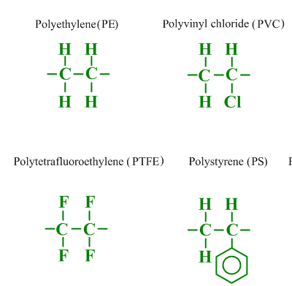
ENGINEERING CHEMISTRY
Module 7- Functional materials-Polymers
nCH₂=CH Peroxide initiator [-CH₂-CH-]_{n}
X
X
Source:https://www.substech.com/dokuwiki/doku.php?id=polymer_structure

Slide 10
ENGINEERING CHEMISTRY
Module 7- Functional materials-Polymers
Salient features:
Linear or branched polymers are produced
Self addition takes place rapidly
No elimination of by products
Addition polymerisation can take place by :
Free radical mechanism – free radical initiator is used
(benzoyl peroxide)
Cationic mechanism- cation is generated using a Lewis acid(AlCl₃)
Anionic mechanism- anion is generated using organometallic compound(BuLi)
Coordination mechanism- Zeigler Natta catalyst is used
(Al(C₂H₅)₃ + TiCl₃)
Molecular weight is an integral multiple of that of the monomer

Slide 11
ENGINEERING CHEMISTRY
Module 7- Functional materials-Polymers
Types of addition polymers
Homopolymer
Copolymer
PVC , PE, Teflon
Styrene-Butadiene rubber
Alternating
Random
Block
Graft

Slide 12
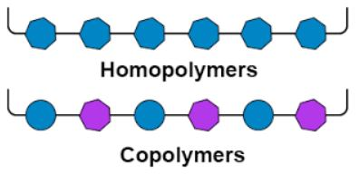
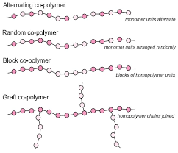
ENGINEERING CHEMISTRY
Module 7- Functional materials-Polymers
Homopolymer – Single monomer unit
Copolymer-Two or more different monomer units
Types of Copolymers
Source:https://byjus.com/chemistry/copolymer/
Source:https://www.essentialchemicalindustry.org/polymers/polymers-an-overview.html

Slide 13
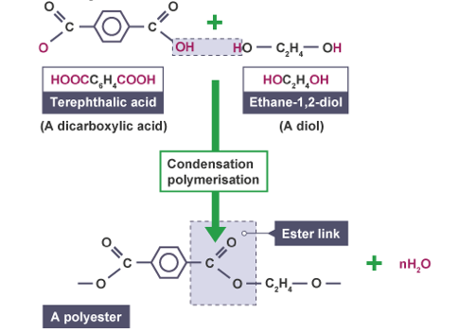
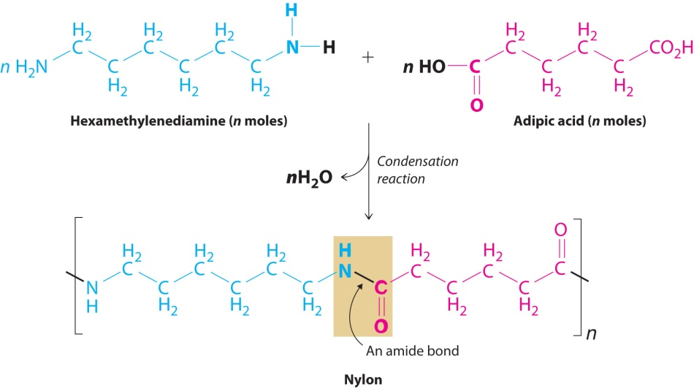
ENGINEERING CHEMISTRY
Module 7- Functional materials-Polymers
Condensation polymerisation: intermolecular condensation through functional groups of monomers with continuous elimination of by products. Examples: Nylons, polyesters, phenol-formaldehyde resin
Nylon 66 Terylene
Source:https://igcse-chemistry-2017.blogspot.com/2017/07/448c-know-that-condensation.html
Source:https://2012books.lardbucket.org/books/principles-of-general-chemistry-v1.0/s16-solids.html

Slide 14
ENGINEERING CHEMISTRY
Module 7- Functional materials-Polymers
Salient features:
catalysed by acids or alkali
continuous elimination of by products
Linear , branched or cross-linked polymers are formed
chain build-up is stepwise
molecular weight of the polymer is not an integral multiple of that of the monomer

Slide 15
ENGINEERING CHEMISTRY
Module 7- Functional materials-Polymers
Addition polymerization | Condensation Polymerization
No elimination of small molecule | Elimination of small molecules like H₂O, NH₃ etc
Initiators are required | Catalyst is required
Linear or branched polymers are formed | Linear ,branched or cross-linked polymers are formed
Molecular weight is an integral multiple of the molecular weight of the monomer | Molecular weight is not integral multiple.
Monomers are unsaturated molecule | Monomer unit must have two active functional groups

Slide 16
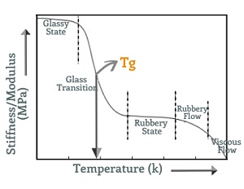
ENGINEERING CHEMISTRY
Module 7- Functional materials-Polymers
Glass Transition temperature
All amorphous polymers, when cooled below a certain temperature, become stiff, hard, brittle and glassy but above this temperature they are soft, flexible and rubbery
This transition temperature of a polymer from glassy state to rubbery state is called its glass transition temperature and is denoted by T_{g}
The rubbery state on heating melts and starts flowing. This temperature is the melting point,T_{m}
Source:https://omnexus.specialchem.com/polymer-properties/properties/glass-transition-temperature

Slide 17
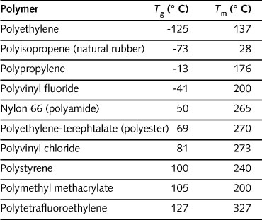
ENGINEERING CHEMISTRY
Module 7- Functional materials-Polymers
glassy state → rubbery state → viscous liquid
The value of T_{g} is a measure of flexibility of a polymer and predicts its response to mechanical stress
Knowledge of T_{g} and Tm is useful in choosing right temperature range for fabrication
The T_{g} value gives an idea of thermal expansion, heat capacity, refractive index, electrical and mechanical properties of a polymer
T_{g} T_{m}
No segmental or molecular motion
Only segmental motion
Molecular mobility sets in

Slide 18
ENGINEERING CHEMISTRY
Module 7- Functional materials-Polymers
Structure - property relationship of polymers
Polymers are extremely versatile when it comes to their properties
Some are hard while others are soft and flexible
Some are insoluble and resistant to heat while others are soluble and fusible
Properties of polymers are influenced by their structure

Slide 19
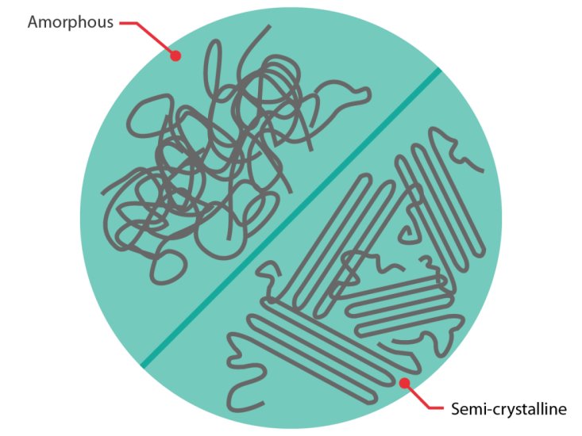
ENGINEERING CHEMISTRY
Module 7- Functional materials-Polymers
Crystallinity :
The degree of cystallinity of a polymer depends on its structure and configuration
Polymers contain both crystalline and amorphous regions
Crystalline regions occur when polymer chains are arranged in an orderly fashion parallel and close to each other
https://coventivecomposites.com/explainers/types-of-polymer-matrix/

Slide 20
ENGINEERING CHEMISTRY
Module 7- Functional materials-Polymers
Structure:
Polymers made up of linear chains without bulky pendant groups are more crystalline
e.g., Polyethylene(PE) is more crystalline then polyvinylacetate
Polymers containing polar groups are more crystalline
A close packing between polymeric chains because of strong secondary forces like dipole–dipole interactions or hydrogen bonding imparts a high degree of crystallinity
e.g., PVC is more crystalline than PE

Slide 21
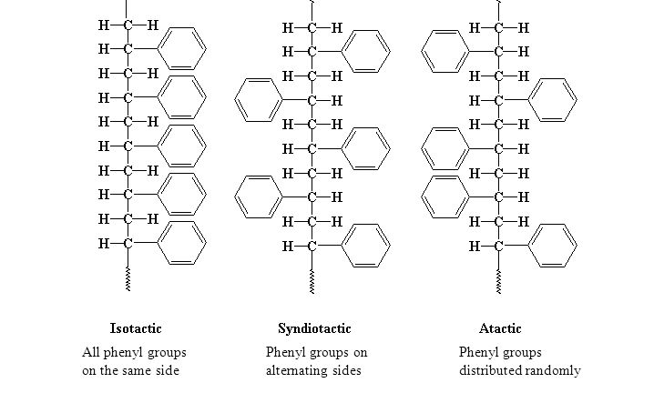
ENGINEERING CHEMISTRY
Module 7- Functional materials-Polymers
Configuration:
Crystallinity also depends on the stereoregularity of the polymer
Based on stereoregularity polymers are classified as isotactic, syndiotactic and atactic
Isotactic polymers are found to be most crystalline while atactic are found to be least crystalline
High crystallinity leads to sharper melting point, greater rigidity, strength and density
Source:https://slideplayer.com/slide/5759919/

Slide 22
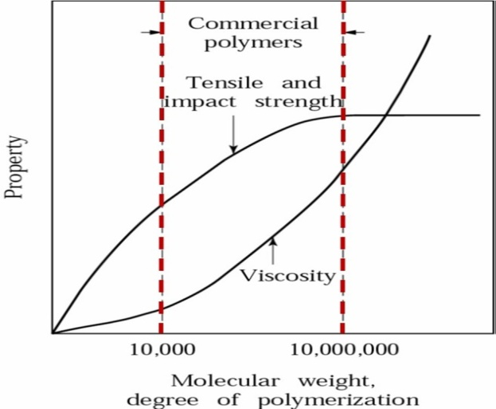
ENGINEERING CHEMISTRY
Module 7- Functional materials-Polymers
Tensile strength:
The amount of stress a polymer can take before undergoing permanent deformation
Tensile strength depends on :
Molecular mass - low molecular mass polymers are soft and
gummy, high molecular mass polymers are tough and heat
resistant
By increasing molecular mass the tensile strength increases to a certain extent and then becomes constant
Melt viscosity initially shows gradual increase then increases steeply with high molecular weight
Source:https://polymerinnovationblog.com/polymer-composites-part-2-introduction-polymer-resins/

Slide 23
ENGINEERING CHEMISTRY
Module 7- Functional materials-Polymers
Tensile strength increases when polymer has polar
groups
Force of attraction between chains prevents polymer
chains from slipping against each other
e.g., PVC, Nylon
Cross linking in a polymer also increases its tensile
strength

Slide 24
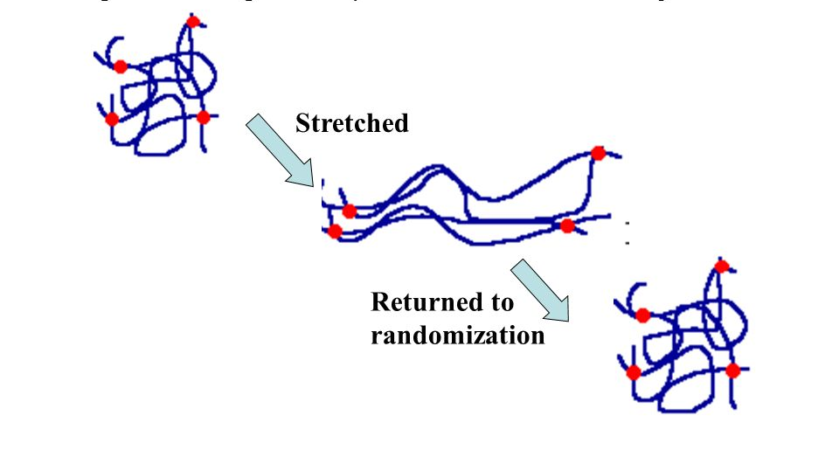
ENGINEERING CHEMISTRY
Module 7- Functional materials-Polymers
Elasticity :
The property of a polymer by which it deforms on applying force and regains original shape on release of force is called elasticity
Elastomers have long coiled and entangled chains which straighten and orient themselves on stretching. When stress is removed they go back to coiled form
For a polymer to show elasticity the individual chains should not break on prolonged stretching
Source:https://slideplayer.com/slide/8755303/

Slide 25
ENGINEERING CHEMISTRY
Module 7- Functional materials-Polymers
Presence of polar groups in the polymer chain results
in strong secondary force of attraction between the
chains making them stiff and inflexible
Non polar groups have weak van der Waal’s
attraction between them and hence they are more
elastic
Presence of bulky, aromatic and cyclic groups in the
polymer decreases the elasticity of the polymer

Slide 26
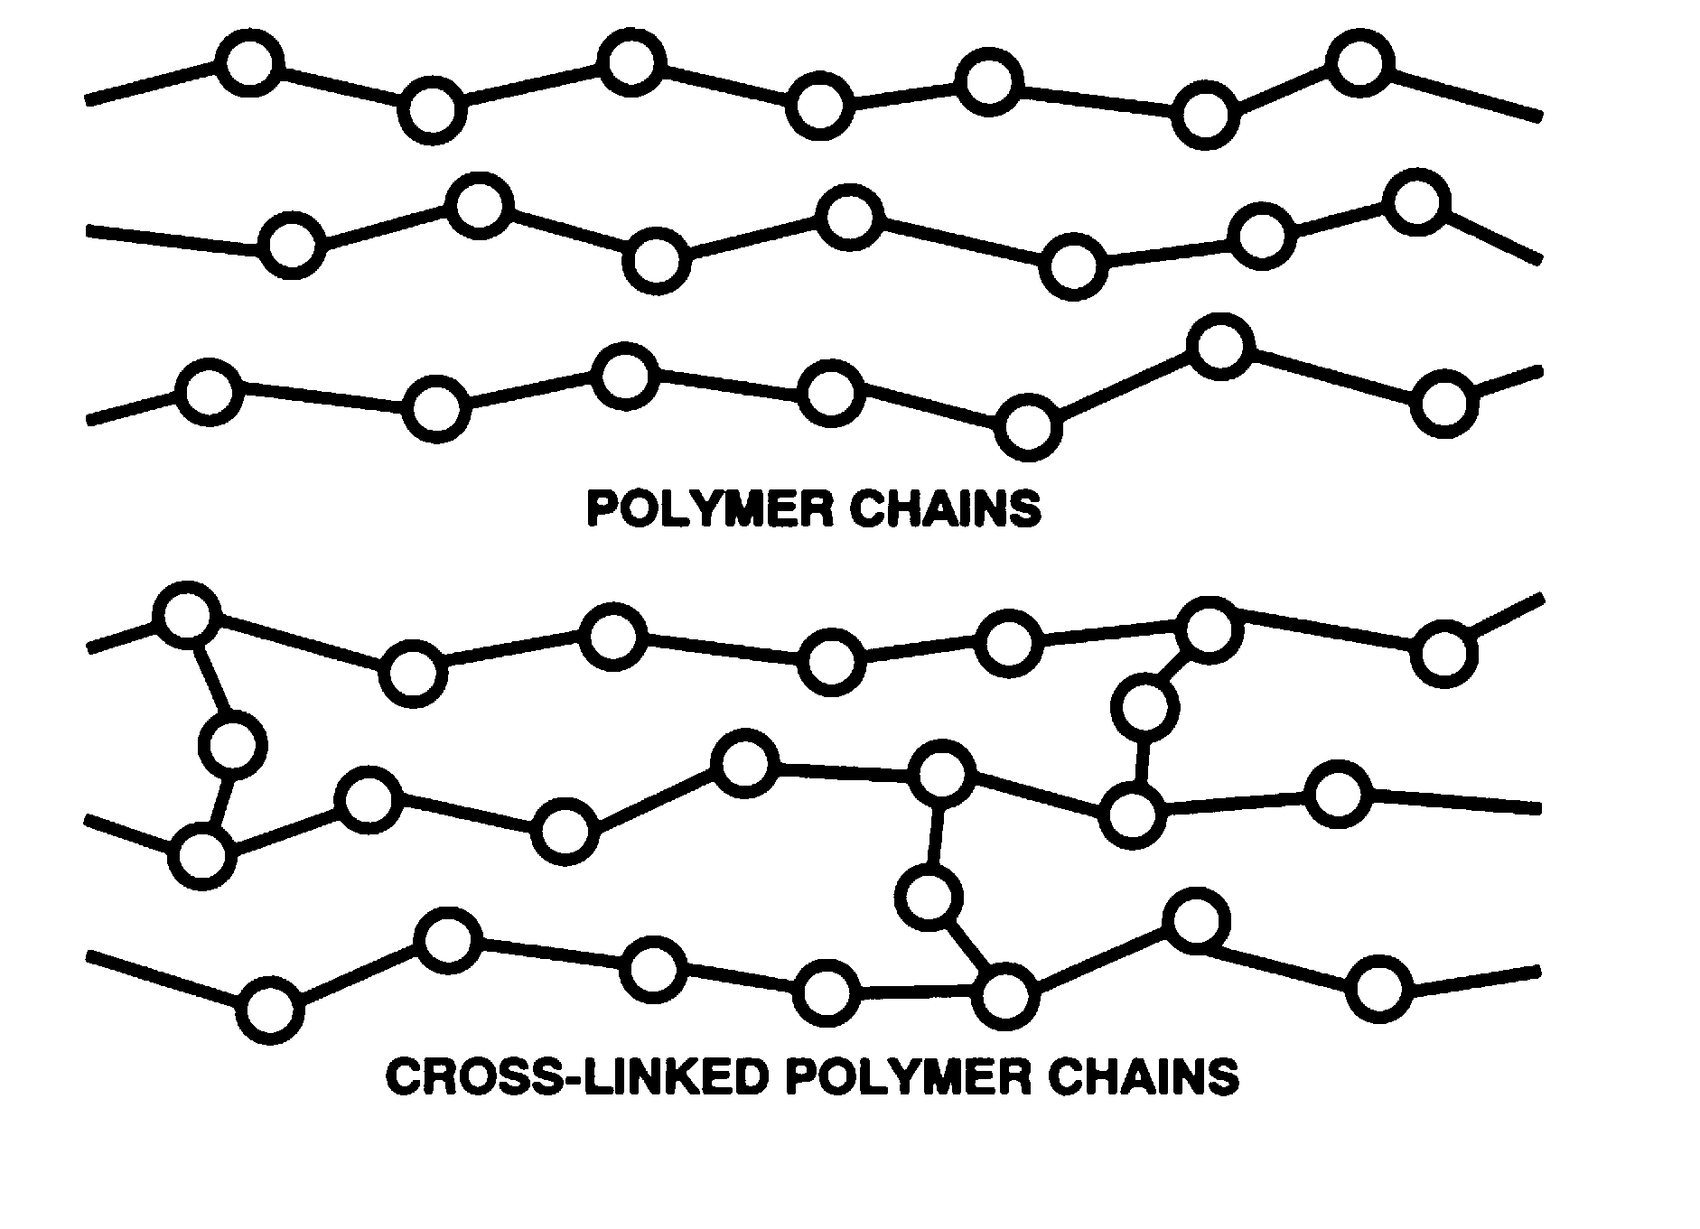
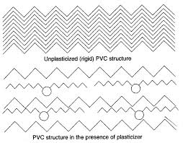
ENGINEERING CHEMISTRY
Module 7- Functional materials-Polymers
In elastic materials such as natural rubber, elasticity can be improved by introducing cross linking at suitable molecular positions like in vulcanisation
In non-elastic materials, elasticity is achieved by using plasticisers , for example (Ph₃PO₄), which enter between the polymer chains and make a hard polymer more flexible
Source:https://revision4gcses.wordpress.com/science/chemistry-2/polymers/
Source:https://www.diva-portal.org/smash/get/diva2:1312811/FULLTEXT01.pdf

Slide 27
THANK YOU
Asha A
Department of Science and Humanities

